Slide 1
Welcome
to August Reuchlen GmbH in Tuttlingen
Surgical instruments for medical technology

Slide 2
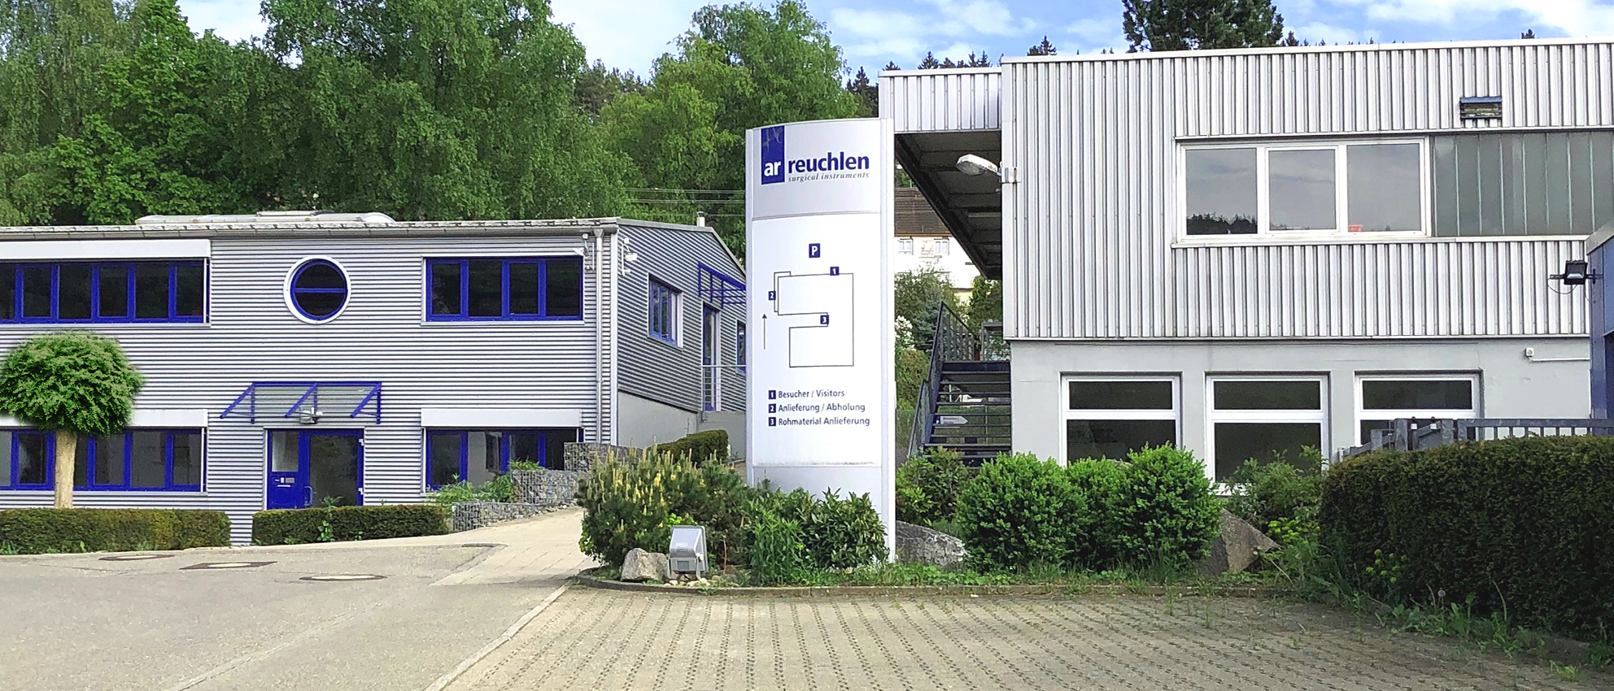
August Reuchlen GmbH has been developing and manufacturing surgical instruments for a wide range of applications in Tuttlingen for over 75 years. Based on many years of experience, we produce high quality instruments in a consistent design.
We work with all materials (stainless steel, titanium, peek, nitinol) and use the most suitable methods for manufacturing.
Our customers are located to all five continents and provide surgeons with the best instruments.
international established manufacturer in medical technology
wide production of implants and surgical instruments
machinery: CNC-controlled milling and turning centers, erosion and laser technology
customers from all over the world
about 50 employees

Slide 4
Our objective for the benefit of the patient
customer satisfaction
satisfied and motivated employees
partnership with our suppliers
investment in future-proof jobs
avoiding errors and cost-conscious acting

Slide 5
Hightest quality Minimal tolerances and identical reprocucibility
since 1995: certificated to ISO 9001 and EN 46001
since 2001: certificated to DIN EN ISO 13485
controlled work processes
innovative technology
permanent quality controls
skills and experience our partly longtime employees

Slide 6
Our products according to field of application
cardiovascular surgery incl. neonatal and pediatric
thoracic and lung surgery (MICS/VATS)
neurospine incl. Caspar, McCulloch
minimal invasive surgery
orthopedic instruments and implants
ENT and plastic surgery
general surgery

Slide 7
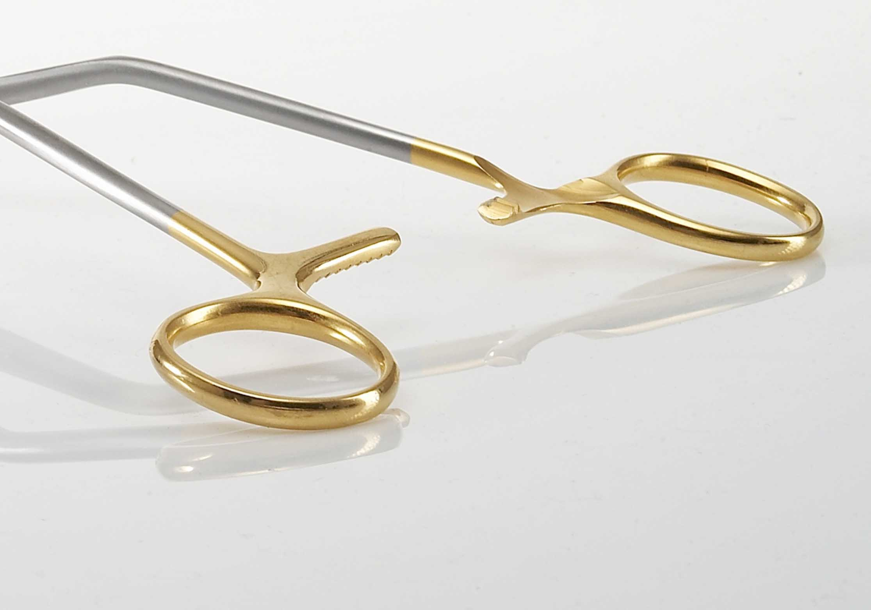
cardio
vascular
instruments for
cardiovascular surgery and further equipment
Atrauma Forceps (Cooley, DeBakey, Glassman)
Bulldog- and Insert Clamps
Thoracic Retractors
Dilators
Needle Holders

Slide 8
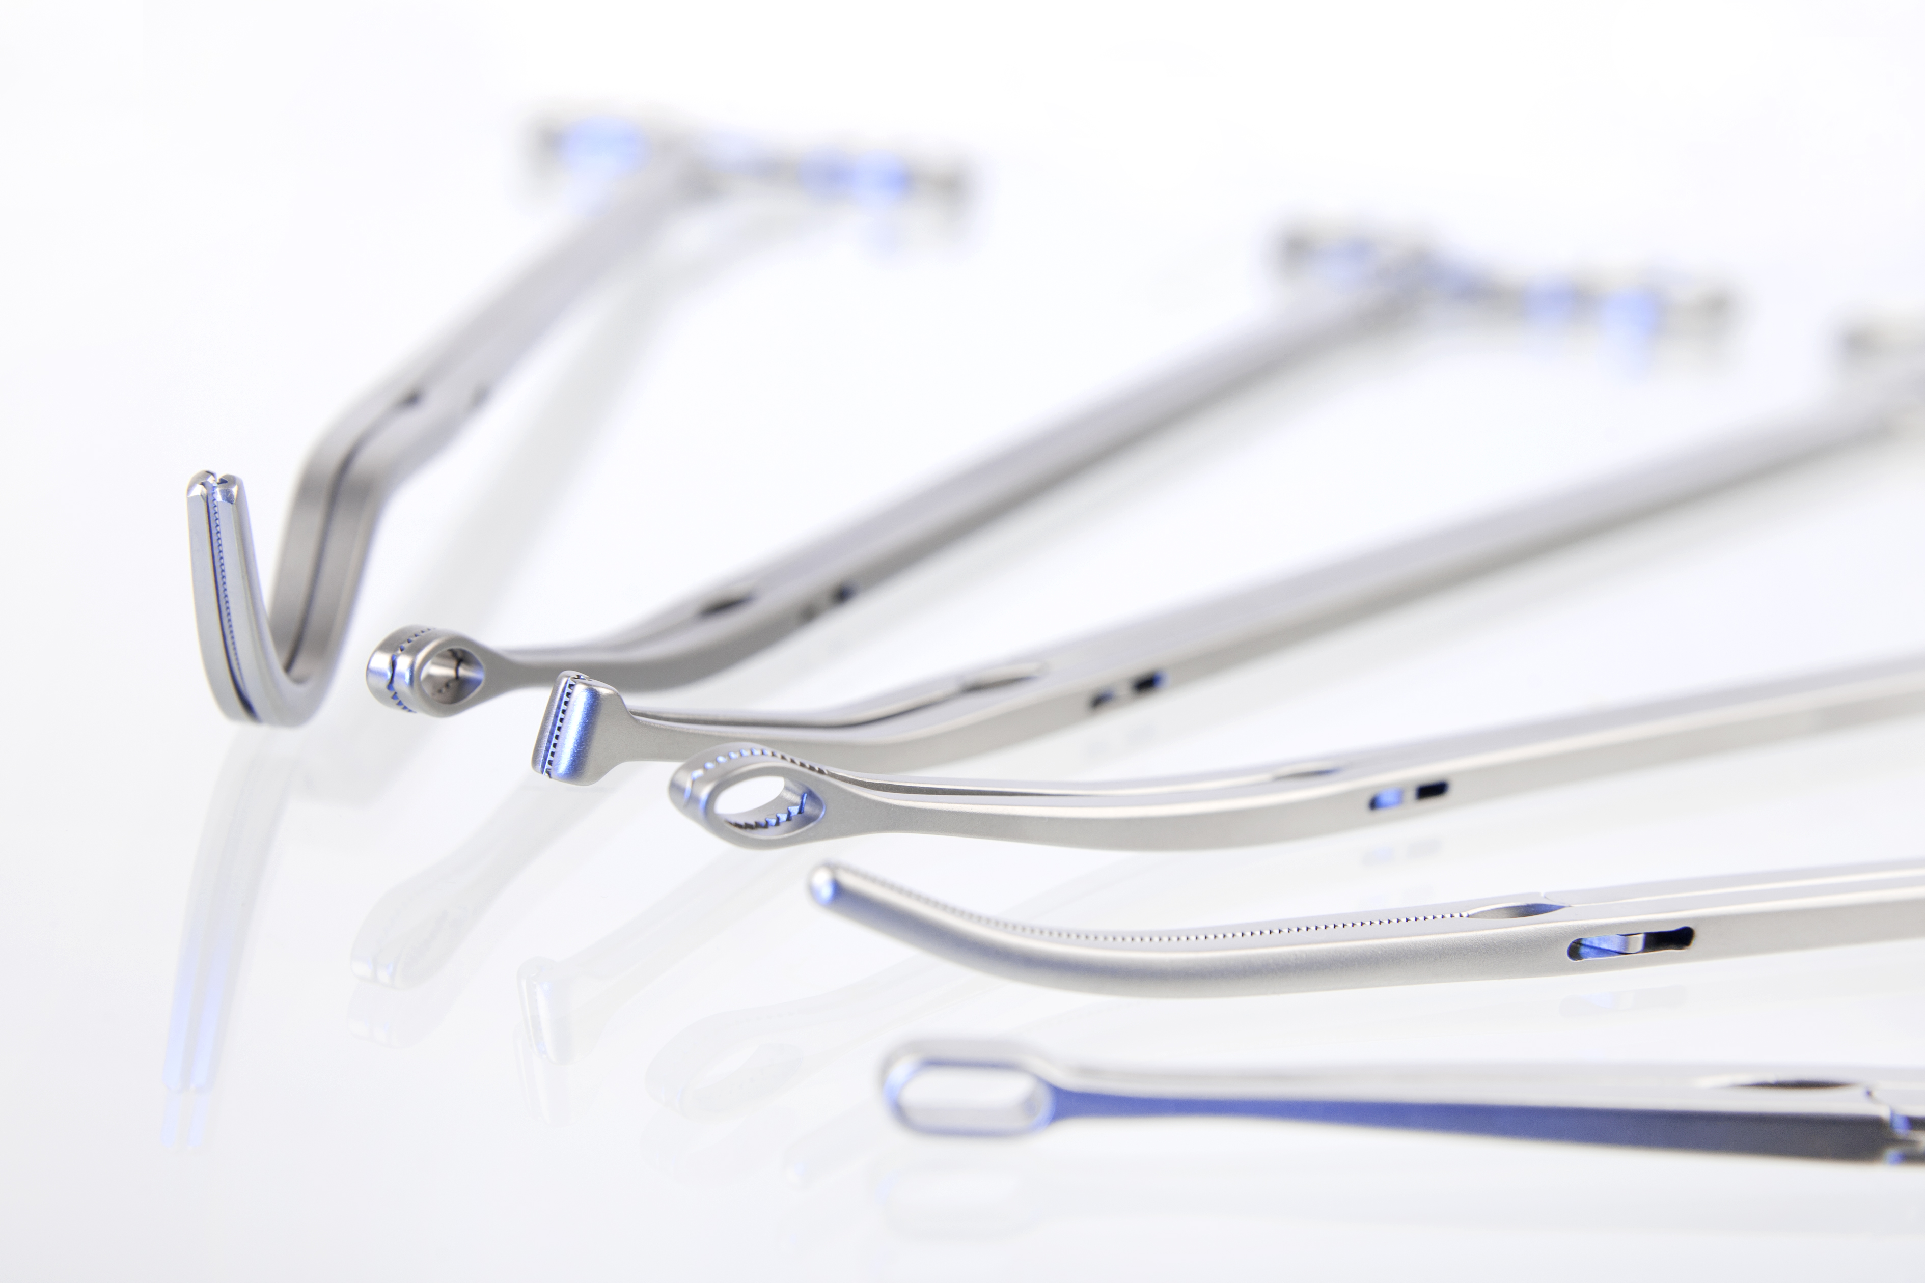
MICS / VATS
Minimal
Invasive
Cardio
Surgery
Video
Assistant
Thoracic
Surgery
Clamps
Scissors
Suction Tubes
Minimal Invasive Surgery
Instruments can be easily cleaned and be flushed through.

Slide 9
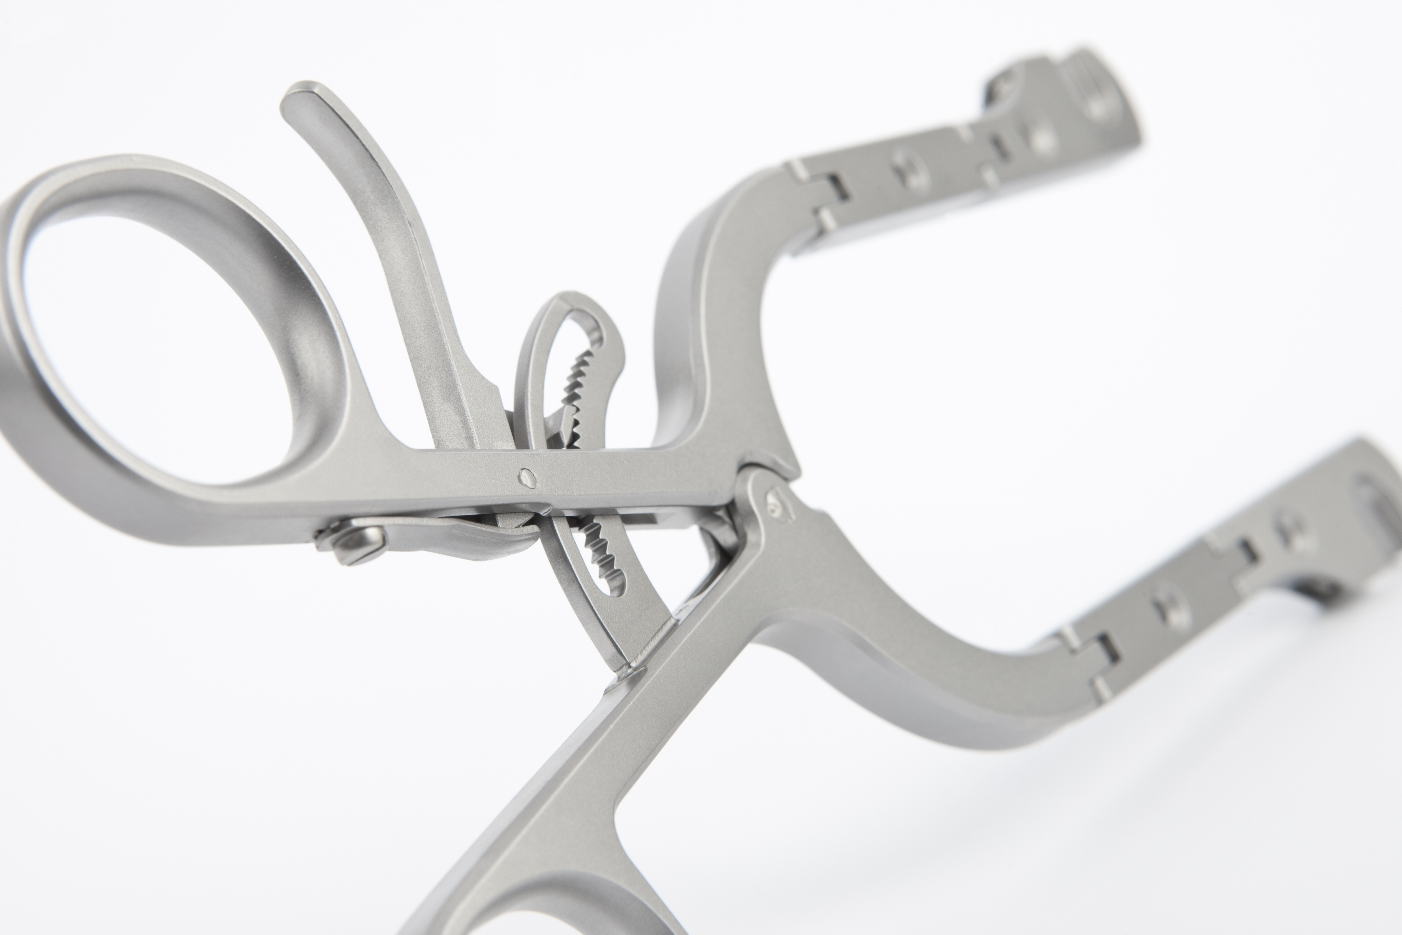
Caspar
McCulloch
Scoville
French
Retractors
Valves
Equipment
Spine Systems
For spine we produce standard retractors as well as three different spine systems:
Scoville-System, McCulloch-System and the Reuchlen Cervical-System Caspar (RCS).

Slide 10
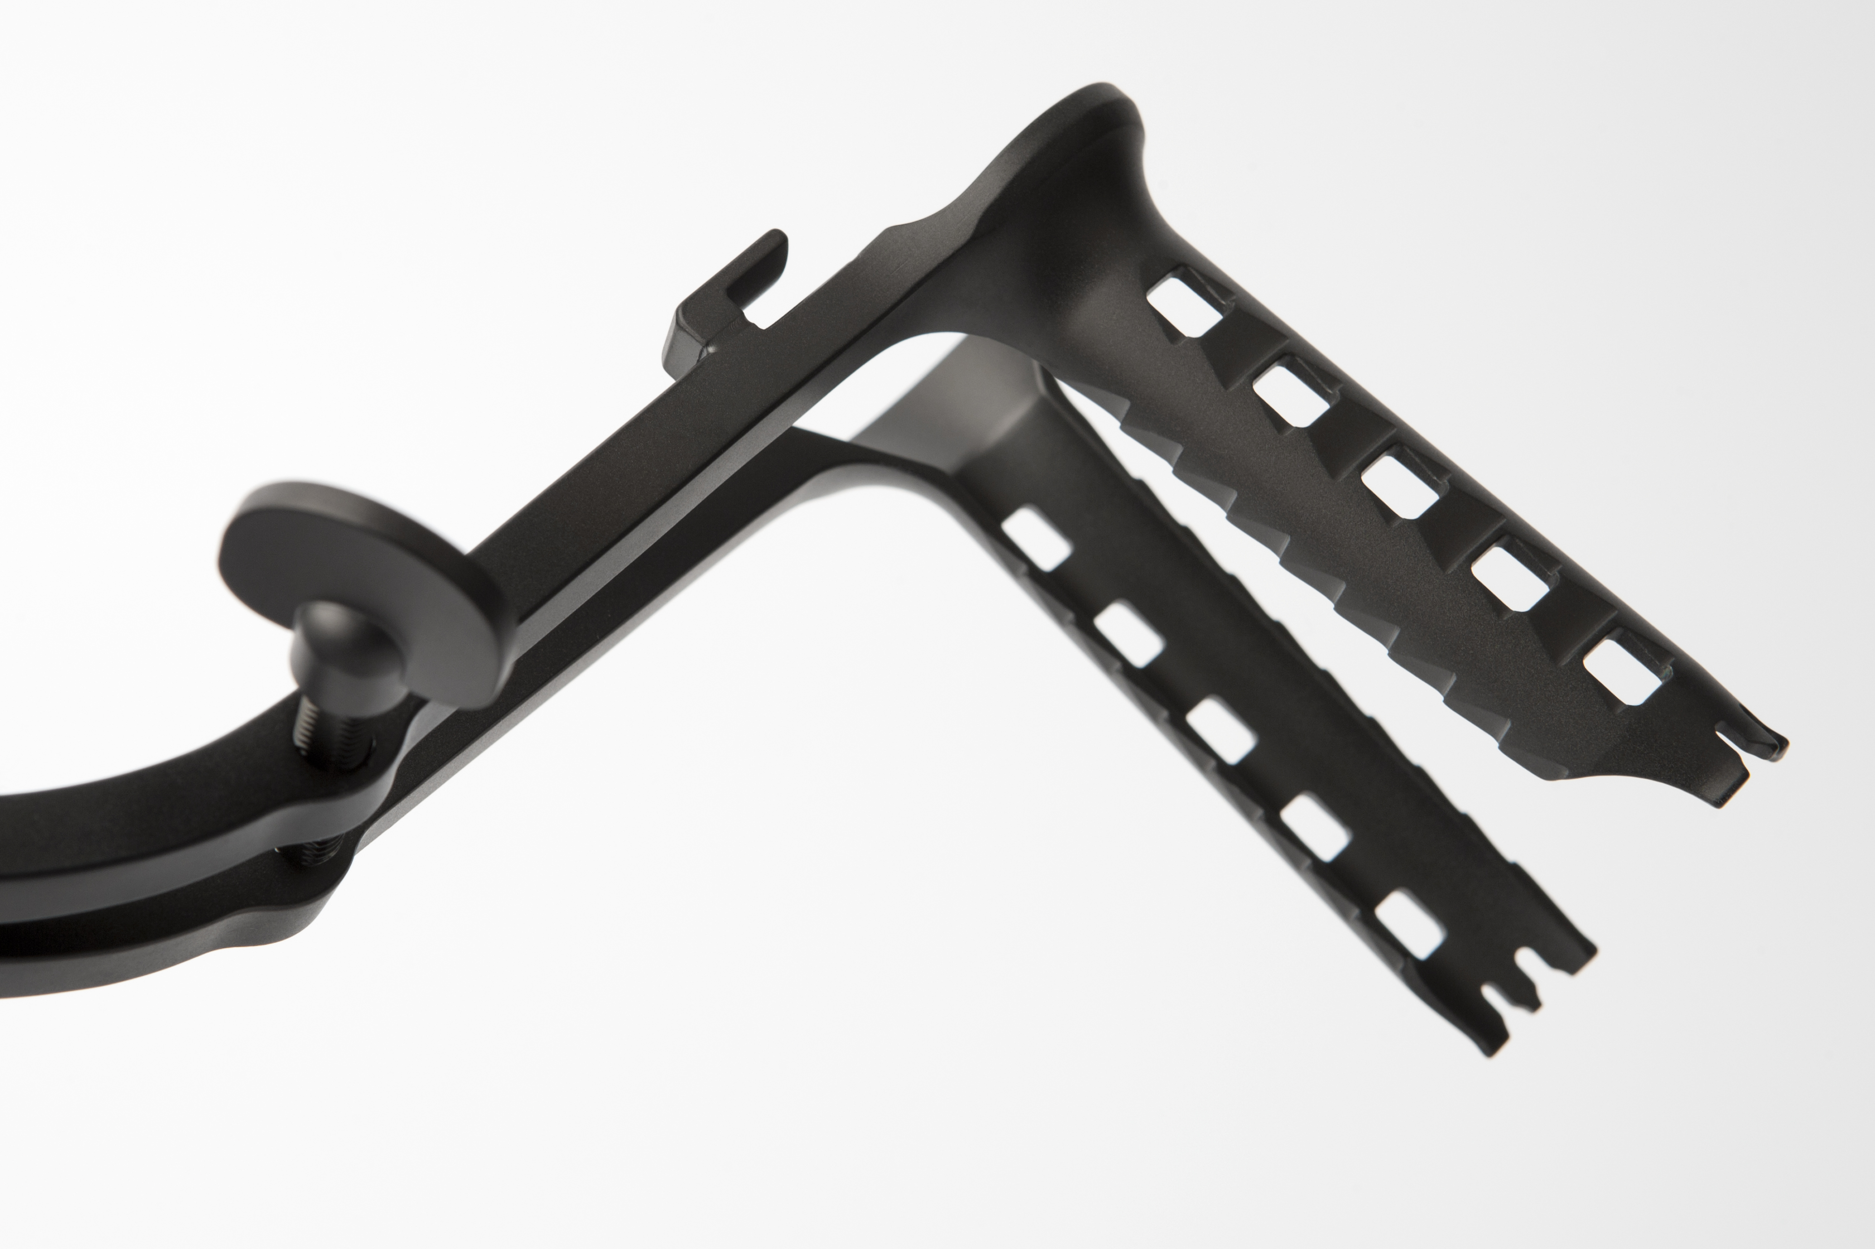
Caspar
Retractors
Valves
Equipment
Retractor System
for cervical vertebrae and lumbar spine

Slide 11
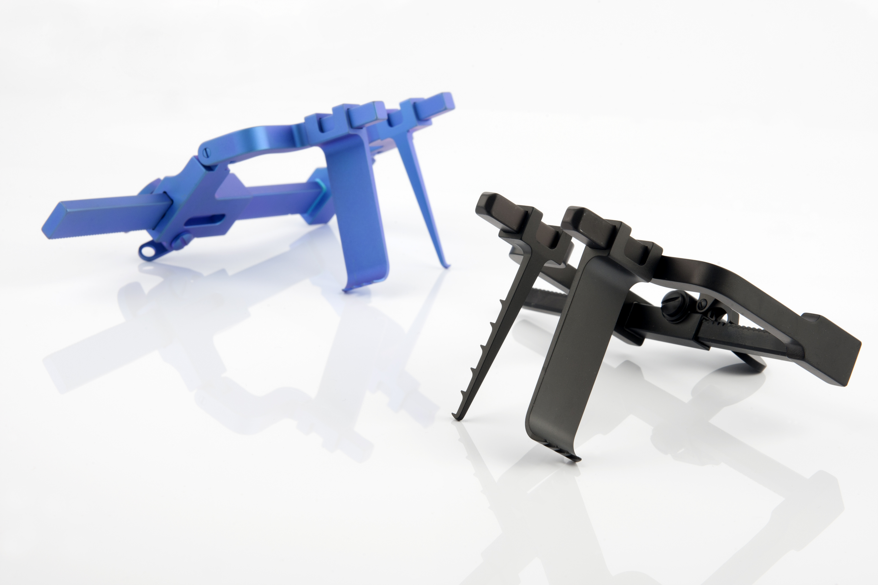
McCulloch
Retractors
Valves
Equipment
Retractor System for intervertebral disc disease
coating prevents reflection of light effects
rack and pinion machanism with fine toothed gear
available in steel and titanium

Slide 12
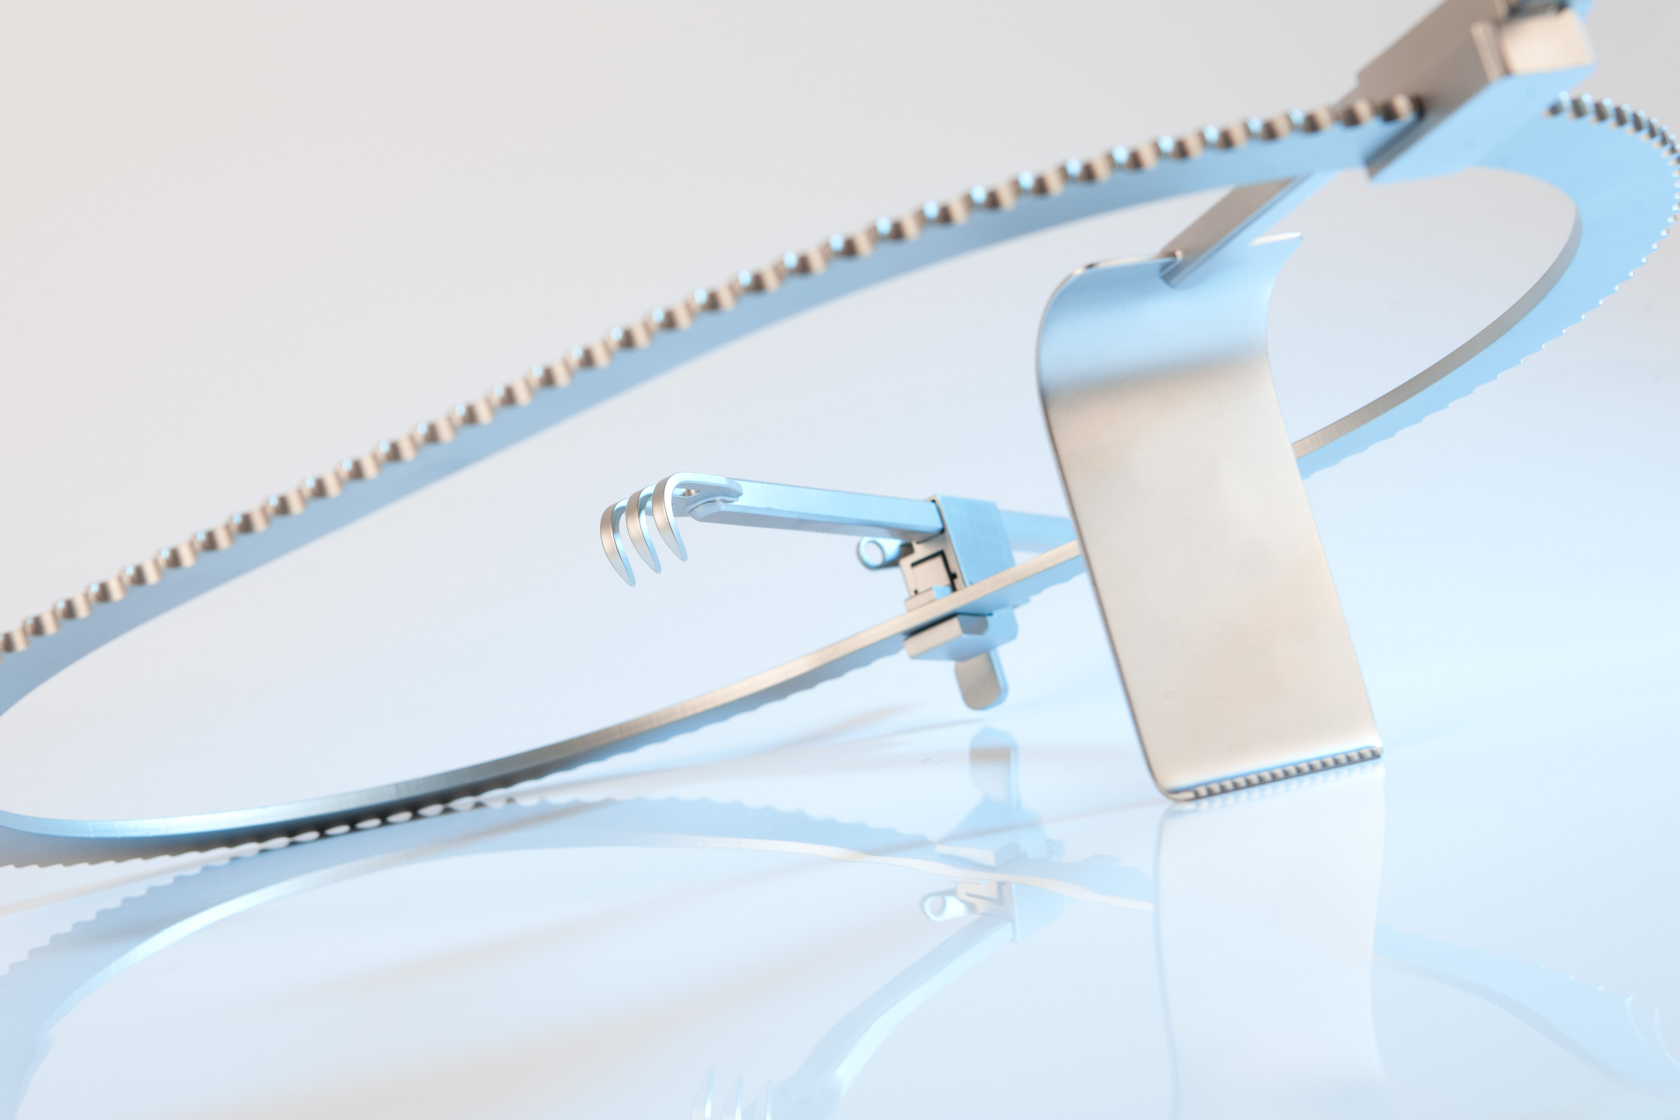
Ring
Retractor
Frames
Ratchets
Blades
Table-Retractor System for variable use
A flexible ring retractor system for various applications,
which can be expanded as required with a wide range of
different sizes of rings, leaves etc.

Slide 13
Construction The interface between product idea and production
function
ergonomics
biocompatibility
material selection
norming, exchangeability and tolerance selection
selection of suitable production techniques and processes

Slide 14
Take a closer look: for reuchlen every little detail
stands for Our dedication to the hightest levels of
quality and precision.

Slide 15
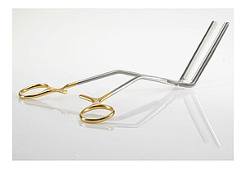
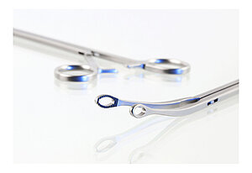
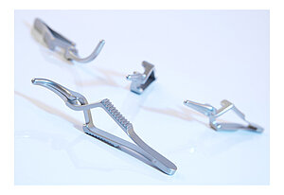
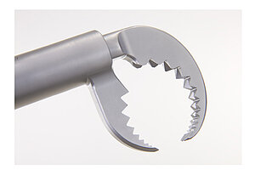
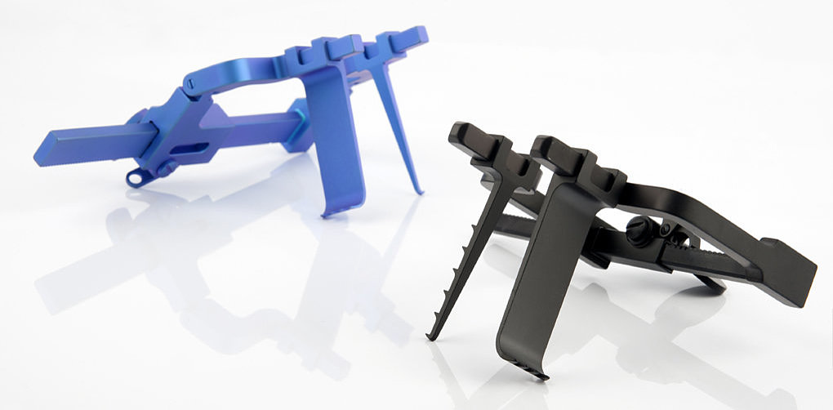
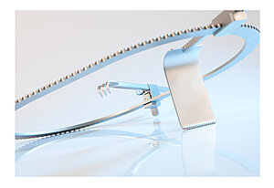

Slide 16
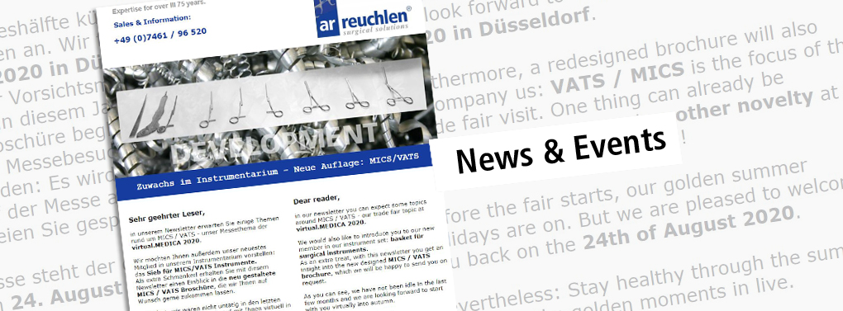
Sign up for our Newsletter.
info@reuchlen.com

Slide 17
We look forward to your visit:
www.reuchlen.com
Products I collaboration I development I fulfillment

